Slide 1
Public Quantitative Disclosure Global Statistical Bulletin Q2 2019 October 2019

Slide 2
The CCP12 Global Statistical Bulletin
The CCP12 Global Statistical Bulletin gives an overview of the risk management provided by Central Counterparties around the globe. It seeks to complement existing public statistics, such as the BIS derivatives statistics, by providing a summary of key indicators. The data is compiled directly from the source – the CCPs themselves – according to a standardized template carrying information stipulated in global regulatory guidance. Further details for individual CCPs can be found in links provided on the CCP12 website (http://ccp12.org/ccp12-public-quantitative-disclosures/). This statistical bulletin helps to inform participants, authorities, and the general public of key features of the scale and nature of financial market infrastructure risk management. This publication underlines the scope and scale of risk mitigation provided by central clearing. In this collation 39 CCPs (representing 24 CCP12 members) are included: 11 CCPs from the Americas, 15 CCPs from APAC, and 13 CCPs from EMEA For Q2 2019 the CCPs included in the collation require over USD 746 billion of initial margin and USD 92 billion default fund resources CCPs risk-manage their clearing exposure by collecting mark-to-market losses through regular variation (or similar) margin payments CCPs exposure to credit risk is collateralized through high-quality and liquid collateral Please send your questions to: question.pqd@ccp12global.com

Slide 3
Highlights of Public Quantitative Disclosures Q2 2019 (in $B USD)
Global Initial Margin Requirement *
Global Initial Margin Requirement *
Total Global Initial Margin Requirement * | $746
Total Global Default Fund Requirement * | $92
Total Global CCP Collateral Requirement * | $838
Total Global Average Daily Variation Margin | $31.6
Global CCP Collateral Held * in form of:
Cash | Initial Margin | Default Fund
At Central Bank | 11% | 35%
Secured Cash (incl. Reverse Repos) | 11% | 15%
Unsecured at Commercial Banks | 5% | 11%
Non-Cash
Sovereign Government Bonds – Domestic | 36% | 29%
Sovereign Government Bonds – Foreign | 18% | 4%
Agency Bonds | 1% | 4%
State/ Municipal bonds | 0% | 0%
Corporate Bonds | 6% | 1%
Equities | 8% | 0%
Mutual Funds / UCITs | 0% | 0%
Commodities - Gold | 0% | 0%
Commodities - Other | 0% | 0%
Other | 3% | 1%
* Figures as of quarter end, Sum of IM Required split by House/Clients (Net and Gross) is lower than Total IM required, due to no breakdown of IM required of NSE and HKSCC

Slide 4
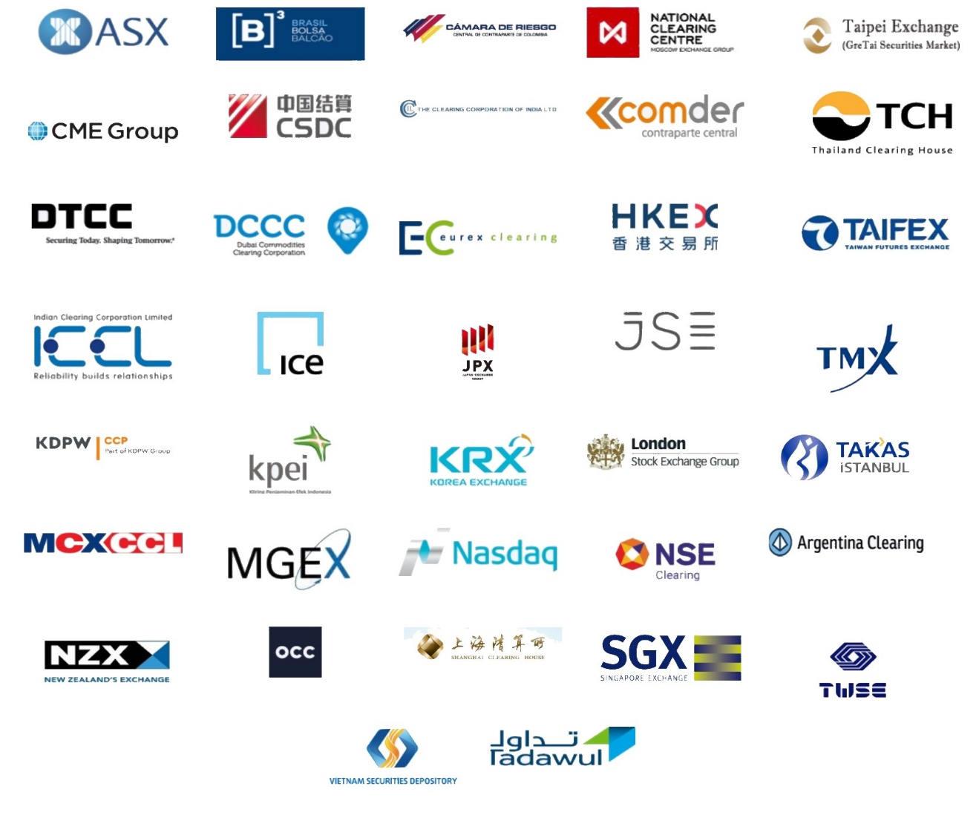
CCP12 Members

